Slide 1
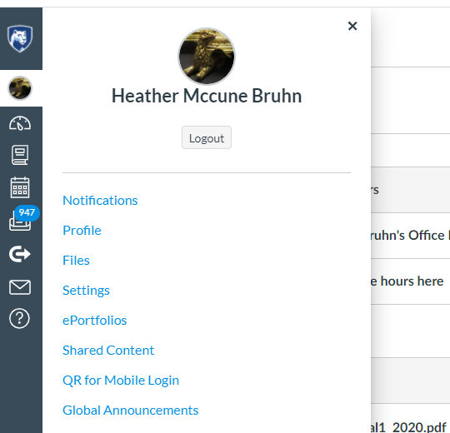
Changing your preferred pronouns in Canvas
Click here first
Next, click here
Click on your account icon (top, beneath the PSU logo). A menu will pop out. Next, select your Settings (fourth item down on the list).

Slide 2
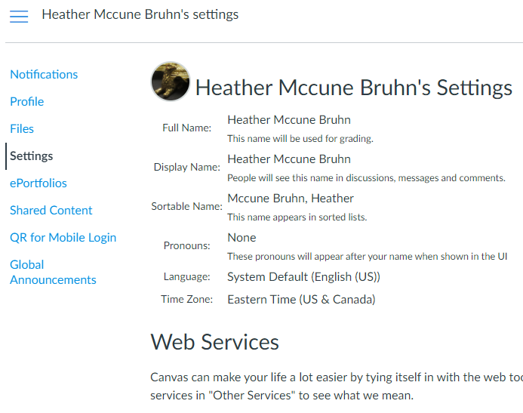
Information on pronouns
The settings menu will give you a number of options for customizing your profile, including the ability to specify your pronouns. If you scroll down on the page, you will also find several accessibility settings (high contrast, etc.).
On the right-hand menu on the Canvas page (not shown), you should click “Edit Settings” in order to make changes.

Slide 3
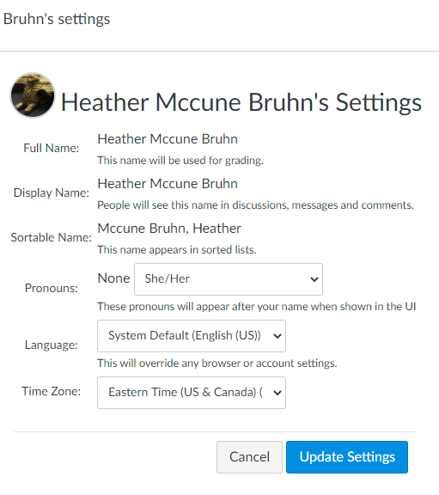
Drop-down menu
Click here when you finish making changes
Select your preference from the drop-down pronouns menu, and click “Update Settings.”

